Slide 1
Detecting and Classifying Abnormal Heart Beats from ECG Recordings
And U. Turken
Galvanize Capstone Presentation
June 9, 2020

Slide 2
Background: Heart-health monitoring
Abnormal in heart beat rhythms are warning signals
Heart attacks and stroke can be predicted in advance
Clinical electrocardiogram (ECG) monitoring
ECG monitoring with IoT devices (e.g. smart watches)
ML for automatic ECG abnormality detection
Train machine learning model with expert-labeled ECG data
Detect and classify abnormal heart beats using ECG data from same individuals, assess transfer to new individuals

Slide 3
Electrocardiogram (ECG) Data
MIT-BIH Arrhythmia Database from PhysioNet
30 minute clinical ECG recordings from 43 individual patients
~109,000 expert-labeled heart beats, ~2,500 hear beats / individual
Variable ECG abnormality across individuals, from 1% <, to > 50% (Overall, 14% of all ECG segments are labeled as abnormal)
~50% generally normal, ~50% with significant abnormality
Type of abnormality recorded on continuous ECG
Commonly used as a benchmark since 1990s
Single channel data, recorded at 360 Hz, comparable to smartwatch

Slide 4
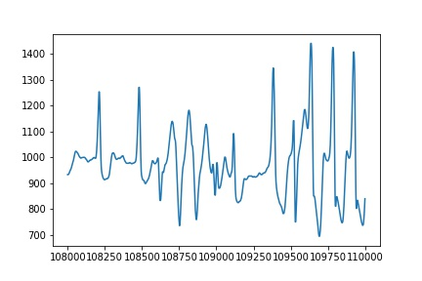
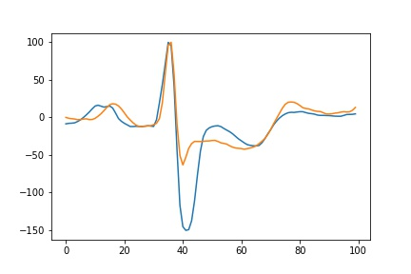
ECG data pre-processing
Read continuous ECG into Python, visually
inspect data quality
Extract ECG segments for each heart beat
Individual segments should comparable!
Extensive pre-processing required
Apply linear drift correction (detrend)
Align segments so same peak latency
Baseline correction
Minimal temporal smoothing
Scale ECG peak amplitude to 100
Remove noisy segments
Recording artifacts: ~2% of data excluded
Continuous ECG recording
Preprocessed ECG segment = One heart-beat

Slide 5
Modeling Approach
Assess how well abnormal hear beats can be detected and classified in new unseen ECG data from the same group of individuals (n=28)
Assess how well abnormal hear beats can be detected and classified in new ECG data from a new group of individuals (n=15)
Two approaches:
(1) Use amplitudes for all ECG times points as a feature vector
(2) Representation learning – apply unsupervised learning to learn a compact representation prior to classification (potentially better transfer to data from new groups of individuals)

Slide 6
Modeling with Scikit-Learn
Train – Test split (stratified, to preserve individual class frequencies): 75% - 25% of all ECG segments from 28 individuals
Five-fold cross-validation (CV) for hyper-parameter tuning
Test out-of-sample generalizability: All ECG segments from further 15
Multi-class classification: Normal ECG + Four most common abnormal ECG patterns; Precision, recall, F1 to assess performance
To address class imbalance: “class weight” balancing in Scikit-Learn
Unsupervised representation learning: “sparse” models for compact components that might capture clinically-relevant aspects of ECG morphology. Pipelined with a classification algorithm, representation tuned based on classifier performance with grid search. Batch learning to manage memory requirements

Slide 7
Modeling - Algorithms
Simple baseline: Isolation forest for unsupervised anomaly detection (~69% accuracy for labeling abnormal ECG on test data)
Baseline: K-Nearest Neighbors classifier – tune neighborhood size with CV
Logistic regression classifier – tune L1 regularization
Balanced Random Forest – tune number of trees, number of features / tree
Unsupervised learning: Sparse PCA, Dictionary Learning, ICA – tune number of components, regularization

Slide 8
Results for k-NN, balanced Random Forest and Logistic Regression classifiers
(no unsupervised pre-processing)
kNN - Train-test on same group of individuals precision recall f1-score N 0.99 1.00 1.00 A 0.98 0.92 0.95 L 0.99 0.99 0.99 R 0.99 1.00 0.99 V 0.98 0.97 0.98 macro avg 0.99 0.97 0.98 weighted avg 0.99 0.99 0.99 kNN - Train on group 1, test on group 2 precision recall f1-score N 0.85 0.98 0.91 A 0.19 0.23 0.21 L 1.00 0.42 0.59 R 0.33 0.04 0.07 V 0.59 0.70 0.64 macro avg 0.59 0.47 0.48 weighted avg 0.82 0.83 0.80
bRF - Train-test on same group of individuals precision recall f1-score N 1.00 0.98 0.99 A 0.81 0.95 0.87 L 0.99 0.99 0.99 R 0.99 0.99 0.99 V 0.88 0.99 0.93 macro avg 0.93 0.98 0.95 weighted avg 0.98 0.98 0.98 bRF - Train on group 1, test on group 2 precision recall f1-score N 0.89 0.92 0.90 A 0.08 0.44 0.14 L 1.00 0.38 0.55 R 0.52 0.04 0.07 V 0.38 0.86 0.53 macro avg 0.57 0.53 0.44 weighted avg 0.85 0.79 0.78
Log Reg - Train-test on same group of individuals precision recall f1-score N 0.95 0.97 0.96 A 0.73 0.66 0.69 L 0.92 0.93 0.93 R 0.86 0.85 0.86 V 0.81 0.64 0.71 macro avg 0.85 0.81 0.83 weighted avg 0.92 0.92 0.92 Log Reg - Train on group 1, test on group 2 precision recall f1-score N 0.81 0.91 0.86 A 0.07 0.07 0.07 L 0.04 0.00 0.00 R 0.06 0.04 0.05 V 0.17 0.43 0.25 macro avg 0.23 0.29 0.25
weighted avg 0.73 0.77 0.75
k-NN: best performance with n=3; Balanced RF: best performance with 1000 trees; Log Regression: Heavy L1 regularization
N: Normal ECG, A, L, R, V: Four most common ECG abnormality types

Slide 9
Modeling – Results / Conclusion
Across all models, best performance for prediction abnormal ECG in new data from the same set of individuals
Using low quality ECG data from a single channel, common machine learning algorithms can successfully be applied to detect abnormal heart activity when past data from same patients are available
Relatively poor transfer to unseen population (however performance on single ECG segment is a very stringent criterion)
Contrary to expectation, unsupervised preprocessing gave poorer results ( in each cases, ~5-10% lower performance - results not presented further due potential implementation errors)
Good performance of k-NN and RF suggest that similarity-based approaches might be best suited for this problem. Representation learning remains work in progress

Slide 10
Future work
Need ML solution for isolating heart beats from continuous ECG
Deep learning with data from large populations for transferable ECG pattern recognition
Apply convolutional neural network (CNN) and autoencoder modeling to better characterize ECG morphology
Apply autoencoder to model variability of ECG features within and across patients
Characterize ECG abnormality in terms of relative timing and amplitudes of ECG features for better diagnostic interpretability

